Slide 1
HUMANOID ROBOT
By: Azizi Bin Mohamad Tambi (1919661)

Slide 2
Table of contents
01
02
03
Introduction
History & Applications
Main Components
04
05
06
Building Your Own
Malaysia Market
Conclusion

Slide 3
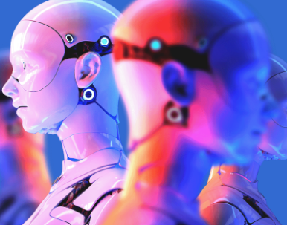
01
INTRODUCTION

Slide 4
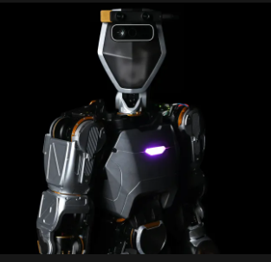
INTRODUCTION
A humanoid robot is a type of robot that is designed to resemble and interact with humans in term of physical appearance, behavior, and capabilities.
The word “humanoid” implies that the robot has characteristics or features similar to those of a human being.
Usually, humanoid robots have a bipedal structure, with an upright stance similar to humans.
They can be equipped with various sensors, actuators and artificial intelligence technologies to perceive and interact with their environment.
They can be used for research and development purposes, exploring human-like movement, behavior, and cognition.

Slide 5
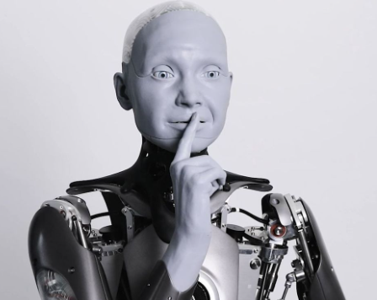
RESEARCH BACKGROUND
The research background for humanoid robot are grouped into several fields such as robotics, artificial intelligence, biomechanics, and cognitive science.
The field of robotics has been focus on creating machines that can perform tasks autonomously or with human assistance.
In biomechanics, researchers studying the mechanics and structure of human bodies have contributed to understanding the principles of locomotion, balance and dexterity.
Advances in AI played a crucial role enabling robots to perceive and understand their environment.
Humanoid robot research draws insights from cognitive science to understand human cognition, behavior, and social interaction.

Slide 6
02
HISTORY & APPLICATIONS

Slide 7
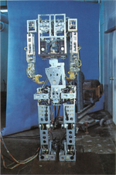
EARLY CONCEPTS
The idea of humanoid robots began to emerge in science fiction literature and films, such as Isaac Asimov’s “I, Robot” series.
Researchers like W. Grey Walter and Valentino Braitenberg explored basic robot behaviors and simple robot designs that vaguely resembled humans.
In 1967, the WABOT-1 was developed by researchers at the Waseda University in Japan.
It was one of the first full-scale humanoid robots.
WABOT-1 could walk, grip objects, and communicate using basic voice synthesis, however its capabilities were limited.

Slide 8
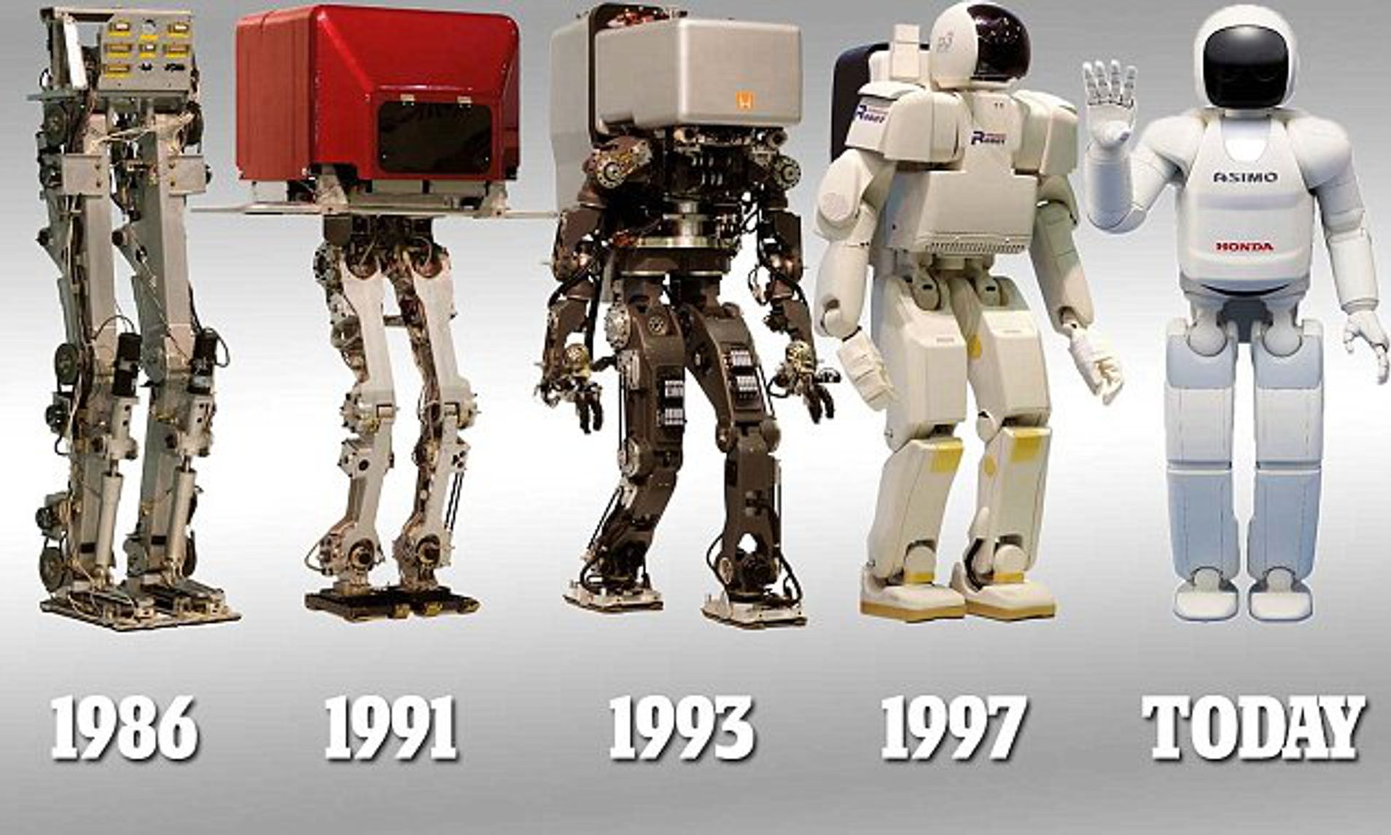
ASIMO
In 2000, Honda’s Advanced Step in Innovative Mobility (ASIMO) made significant advancements in humanoid robotics.
ASIMO was designed to walk, run, climb stairs, and interact with humans.
It could recognize faces, objects and gestures.
ASIMO served as a research platform and a symbol of technological advancement, inspiring further development in the field.

Slide 9
APPLICATIONS
Personal Assistance
-Humanoid robots can assist individuals with daily tasks such as household chores, meal preparation, medication reminders, and mobility support for elderly.
Healthcare
-Can be utilized in healthcare settings to provide companionship to patients, monitor vital signs, assist with physical therapy exercises, and perform basic caregiving tasks.
Education
-Can serve as educational tools, assisting in teaching various subjects, languages, or skills.
Customer Service
-Can act as customer service representatives, providing information, guiding customers, and assisting with transactions.
5. Entertainment
-Can be used for entertainment purposes, such
as performing shows, exhibitions, or theme
parks.
6. Research and Development
-Employed in research laboratories to study
human-like movement, cognition, and social
interaction.
7. Social Companionship
Robots like Pepper and Sophia are designed
to provide social companionship, engaging in
conversations, recognizing emotions, and
providing companionship for people.

Slide 10
03 MAIN COMPONENTS
I. Frame & Hull Design
II. Propulsion System
III. Navigation & Control System
IV. Data Collection
V. Data Transmission
VI. Power Management

Slide 11
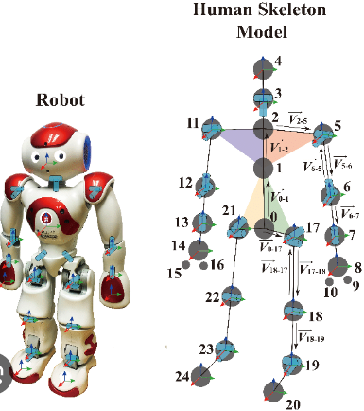
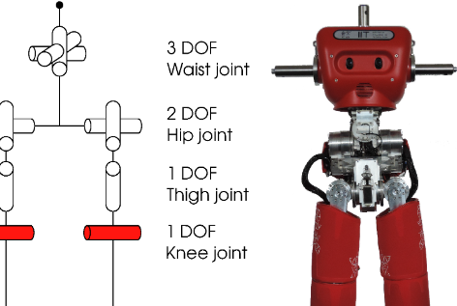
Frame & Hull Design
1. Structural Frame:
2. Joints & Actuators:
The structural frame of a humanoid robot typically provides support and stability to the overall robot’s body.
It is usually made of lightweight and rigid materials such as aluminum, carbon fiber composites, or high-strength plastics.
The frame is designed to withstand the loads and forces generated during movements and interactions.
Humanoid robots have multiple joints, allowing them to achieve a range of movements and postures similar to humans.
Joints are usually actuated by motors, hydraulic systems, or pneumatic systems to provide the necessary force and flexibility.

Slide 12
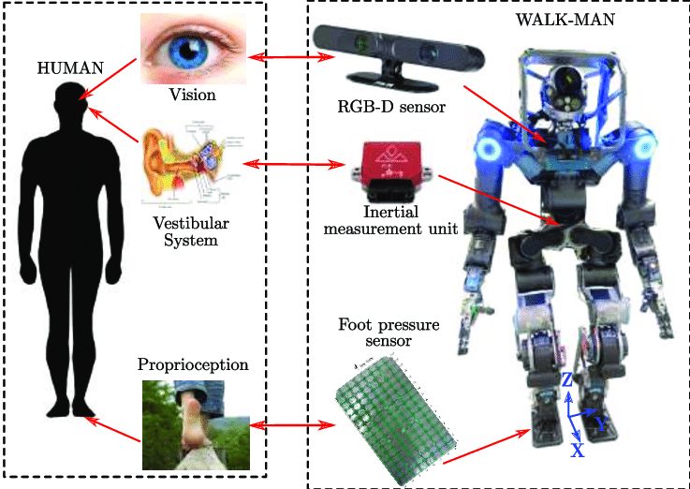
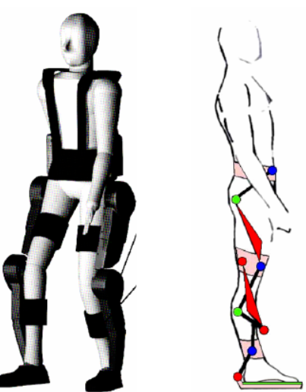
Frame & Hull Design
3. Sensory Integration:
4. Ergonomics & Anthromorphism:
Humanoid robots incorporate various sensors throughout their body to perceive and interact with their environment.
These sensors can include cameras, depth sensors, touch sensors, force sensors, accelerometers, and gyroscopes.
The design of the frame and hull takes into account the optimal placement of sensors to enable effective perception and feedback.
Humanoid robots strive to mimic human form and movement, which involves considering anthromorphic proportions and ergonomics in their design.
The frame and hull are designed to resemble human body segments, with considerations for limb length, joint placement, and range of motion.

Slide 13
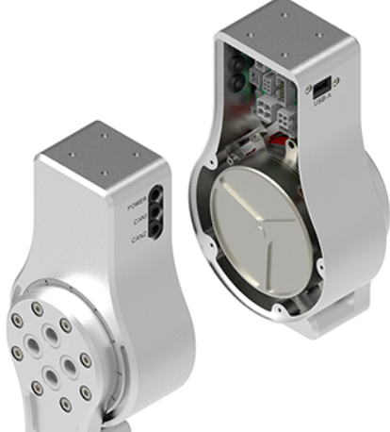
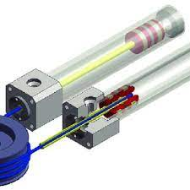
II. Propulsion System
1. Electric Motors:
2. Hydraulic Systems:
Electric motors, such as brushed DC motors or brushless motors, are commonly used.
They provide rotational motion and actuation for the robo’s joints, enabling it to walk, grasp objects, and perform various movements.
Hydraulic actuators offer high power and force capabilities, allowing for precise and dynamic movements.
Often used in robots designed for heavy lifting or demanding tasks.

Slide 14
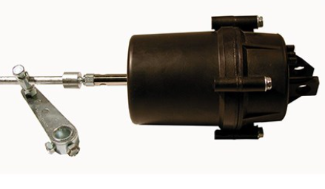
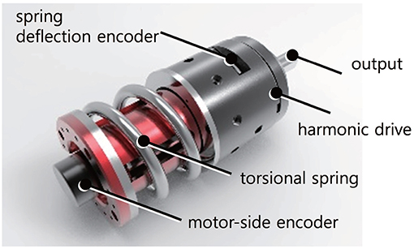
II. Propulsion System
3. Pneumatic Systems:
4. Series Elastic Actuators:
Pneumatic systems, which use compressed air or gas, can provide fast and responsive actuation for humanoid robots.
Pneumatic muscles, also known as artificial muscles can mimic human muscle movements and offer compliance and flexibility.
Series elastic actuators incorporate elastic elements between the motor and the joint to provide compliant and force-controlled movement.
This offer advantages such as impact absorption, force sensing, and energy efficiency, making them suitable for human-like locomotion and interaction.

Slide 15
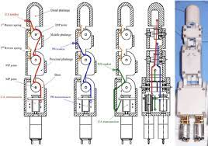
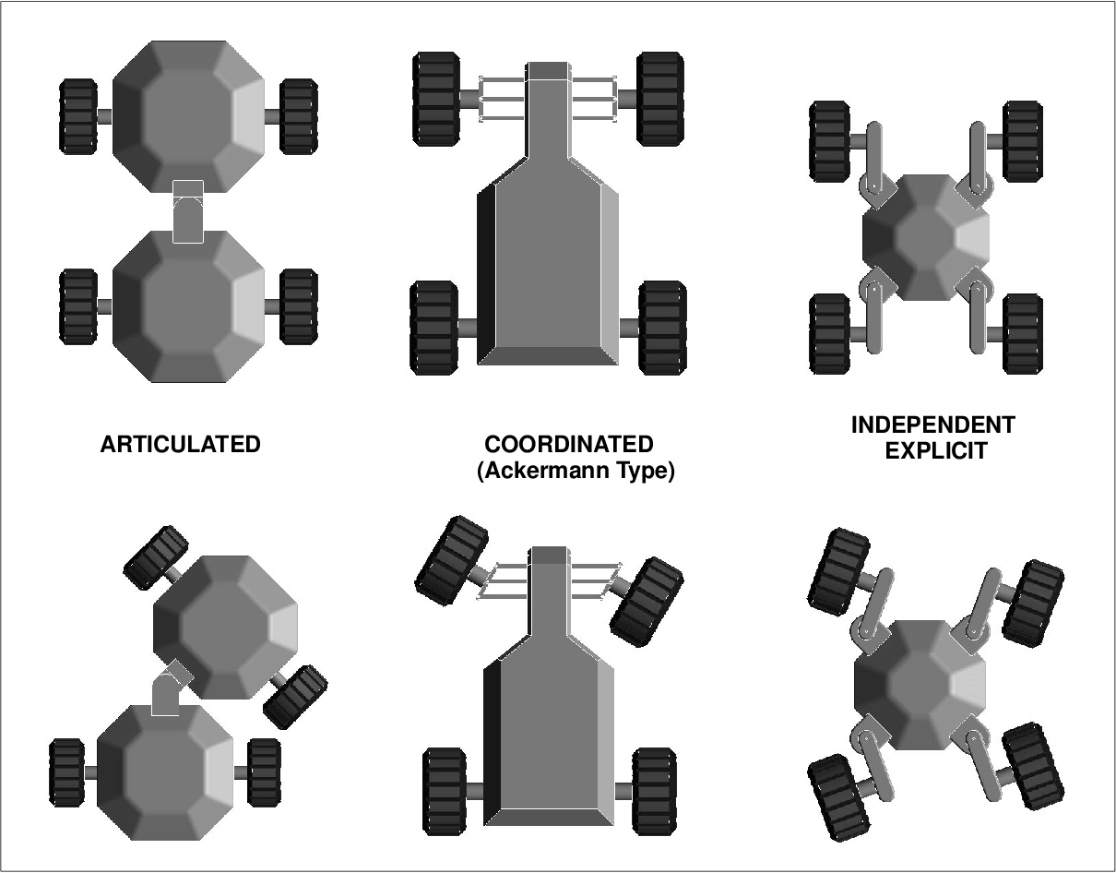
II. Propulsion System
5. Tendon Drive Systems:
6. Wheeled/Legged Locomotion:
This systems utilize cables or tendons connected to the robot’s joints and driven by motors or actuators located elsewhere in the robot’s body.
This arrangement allows for lighter limbs and centralized actuation, providing flexibility and dexterity in movements.
Wheeled systems, often combined with stabilizing mechanisms, allow for efficient movement on flat surfaces.
Legged systems, resembling human or animal legs, enable the robot to traverse diverse terrains and navigate obstacles.

Slide 16
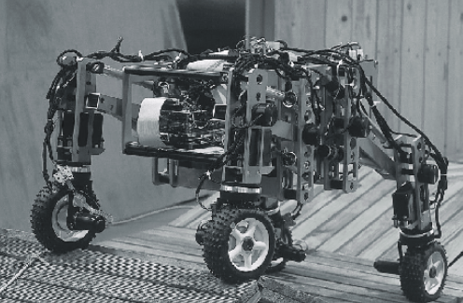
II. Propulsion System
7. Hybrid:
Many humanoid robots combine multiple propulsion systems to achieve versatile and adaptive locomotion.
A humanoid robot may use electric motors for join actuation and incorporate wheels or legs for mobility in different situations.

Slide 17
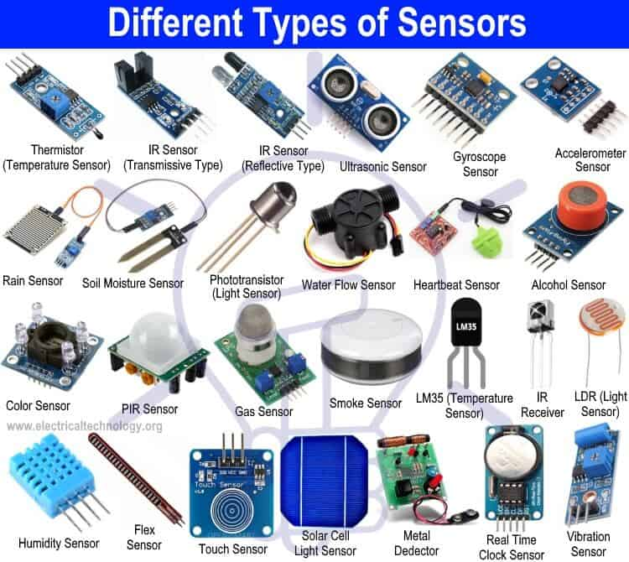
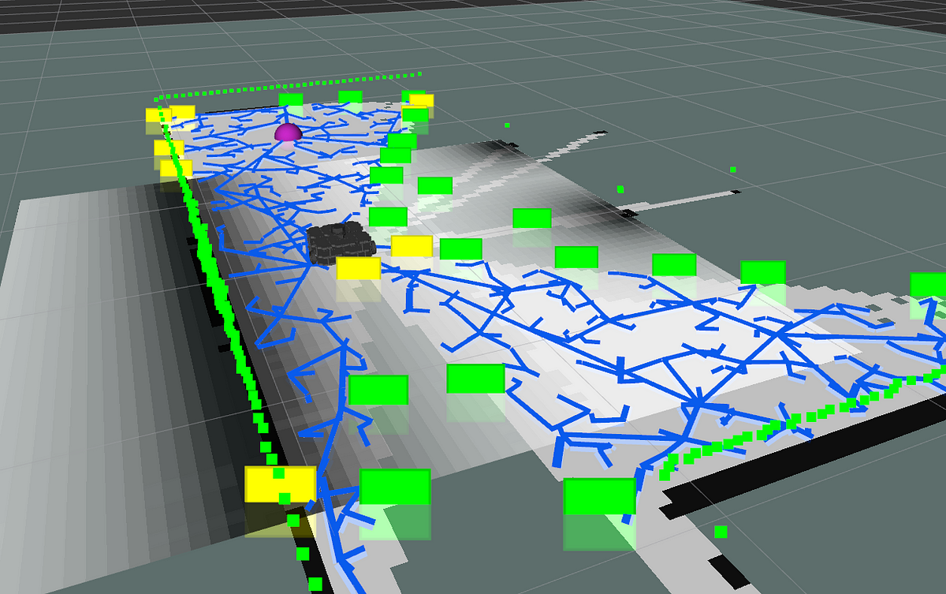
III. Navigation System
1. Sensors:
2. SLAM:
Utilized various sensors for environmental perception, including cameras, depth sensors (such a LiDAR or depth cameras), IMUs and proximity sensors.
These sensors provide information about the robot’s position, orientation, distance to object, and obstacle detection.
Simultaneous Localization and Mapping (SLAM) algorithms are commonly employed to create a map of the environment while localizing the robot within it.
SLAM algorithms integrate sensor data to estimate the robot’s position and create a representation of the surroundings.

Slide 18
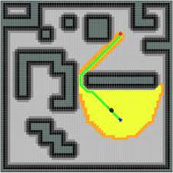

III. Navigation System
3. Path Planning:
4. Obstacle Avoidance:
Path planning algorithms determine the optimal path for the humanoid robot to navigate from its current position to a desired location while avoiding obstacles.
These algorithms take into account the robot’s kinematics, the map of the environment, and any constraints on movement.
Humanoid robots incorporate obstacle avoidance algorithms that use sensor data to detect and avoid obstacles in real-time.
These algorithms adjust the robot’s trajectory or generate alternative paths to avoid collisions.

Slide 19
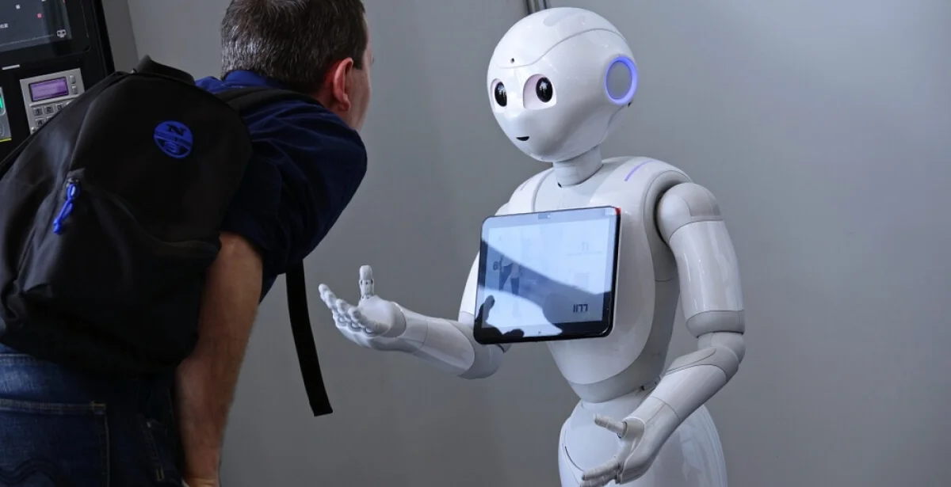
III. Navigation System
5. Human-Robot Interaction:
May have features that enable interaction with humans during navigation.
This include recognizing and following human gestures or commands, as well as predicting human movement for safe and coordinated navigation.

Slide 20
III. Control System
1. Centralized or Distributed Control:
2. Motion Control:
May have centralized or distributed control architectures.
In centralized control, a central processing unit coordinates the robot’s actions.
In distributed control, individual joints or subsystems have their own control units, which communicate and coordinate with each other.
Generate control signals to actuate the robot’s joints and achieve desired movements.
These algorithms can include position control, torque control, or impedance control, depending on the specific requirements and objectives.

Slide 21
III. Control System
3. Stability and Balance Control:
4. Gait Control:
Control algorithms, often utilizing feedback from sensors, adjust joint movements and torques to maintain stability during standing, walking, or performing dynamic movements.
Gait control algorithms determine the timing and coordination of joint movements for walking or running.
These algorithms focus on achieving stable and efficient locomotion, adapting to different surfaces or terrains.

Slide 22
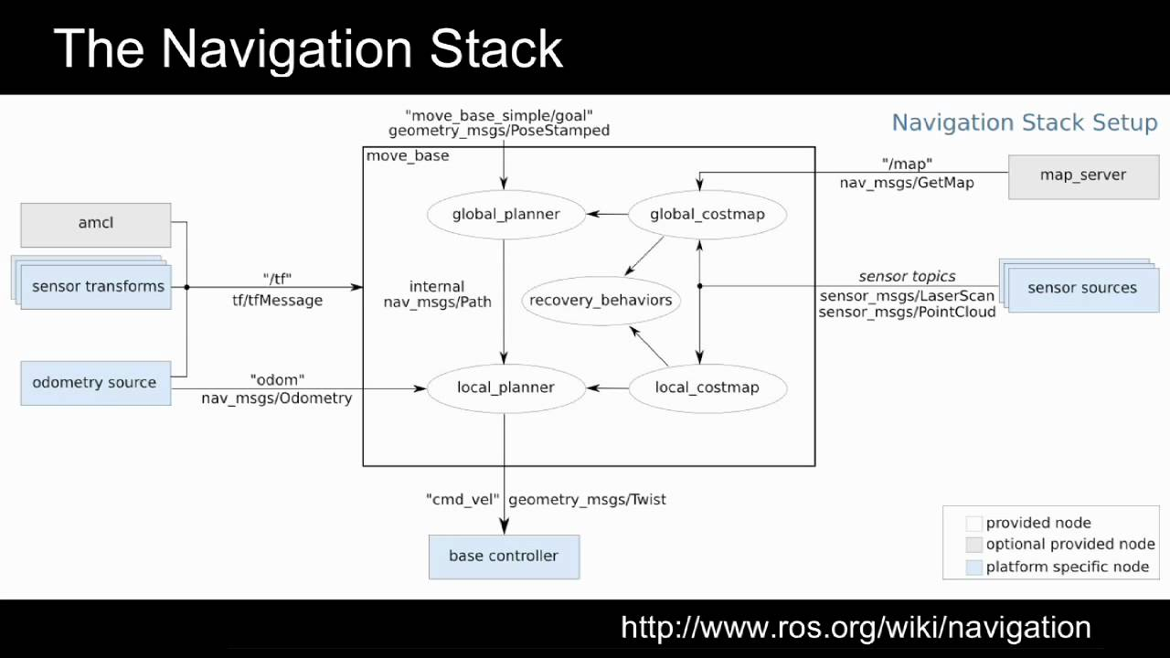
ROS Navigation Stack

Slide 23
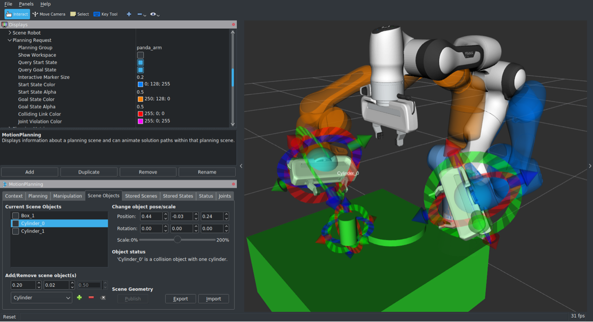
MoveIt!

Slide 24
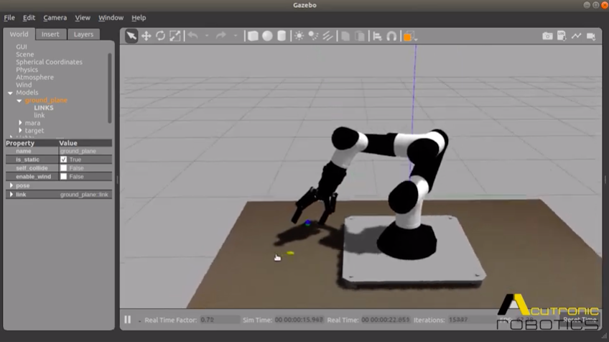
Gazebo

Slide 25
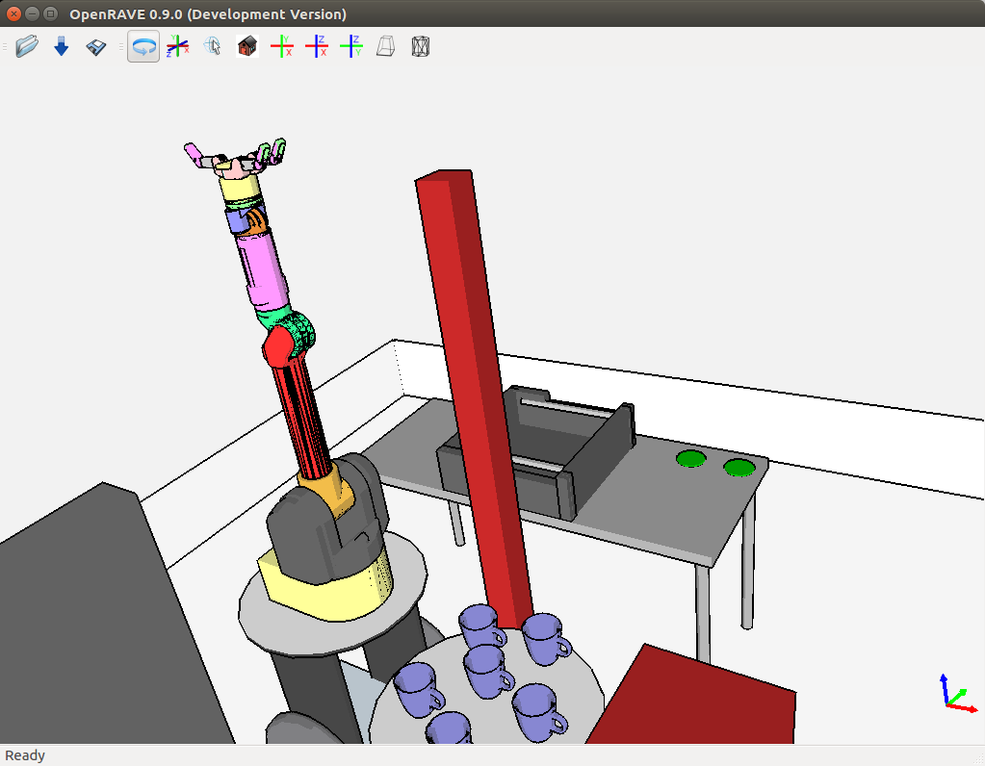
OpenRAVE

Slide 26
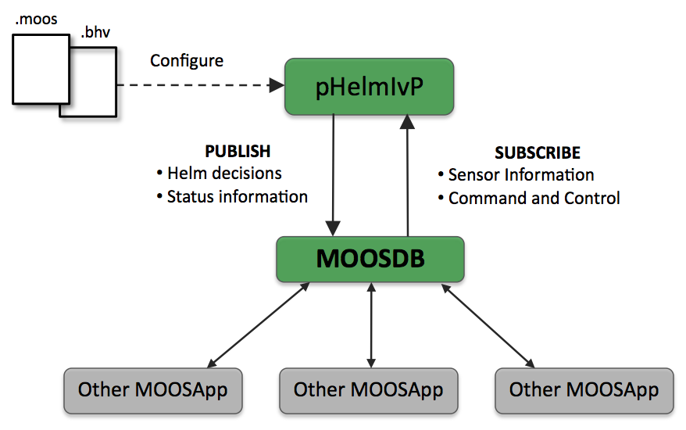
MOOS-IvP

Slide 27
IV. Data Collection
SENSORS
ACTUATORS
Cameras
IMUs
LiDAR
Ultrasonics sensor
Force/Torque sensor
Tactile sensor
Proximity Sensor
Joint Encoders
Microphones.
Electric Motors
Hydraulic Actuators
Pneumatic Actuators
Series Elastic Actuators (SEA)
Tendon Drives
Grippers/End Effectors
Walking Mechanisms

Slide 28
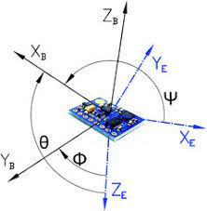
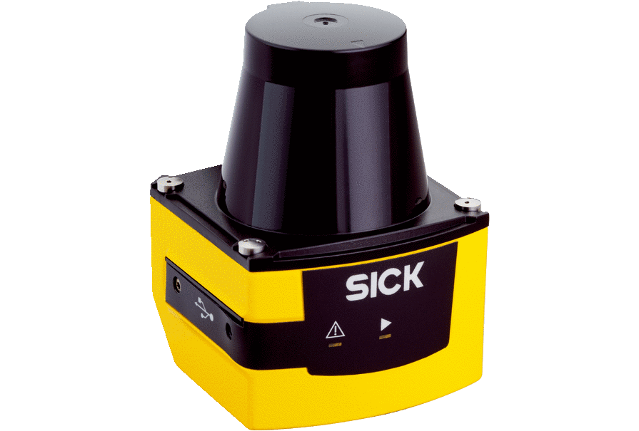
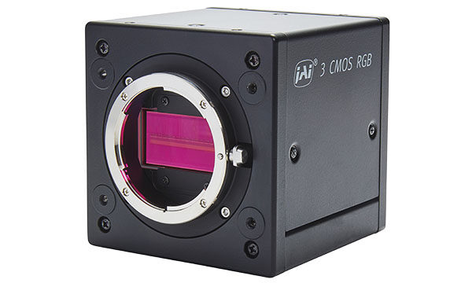
SENSORS
Cameras
IMUs
LiDAR

Slide 29
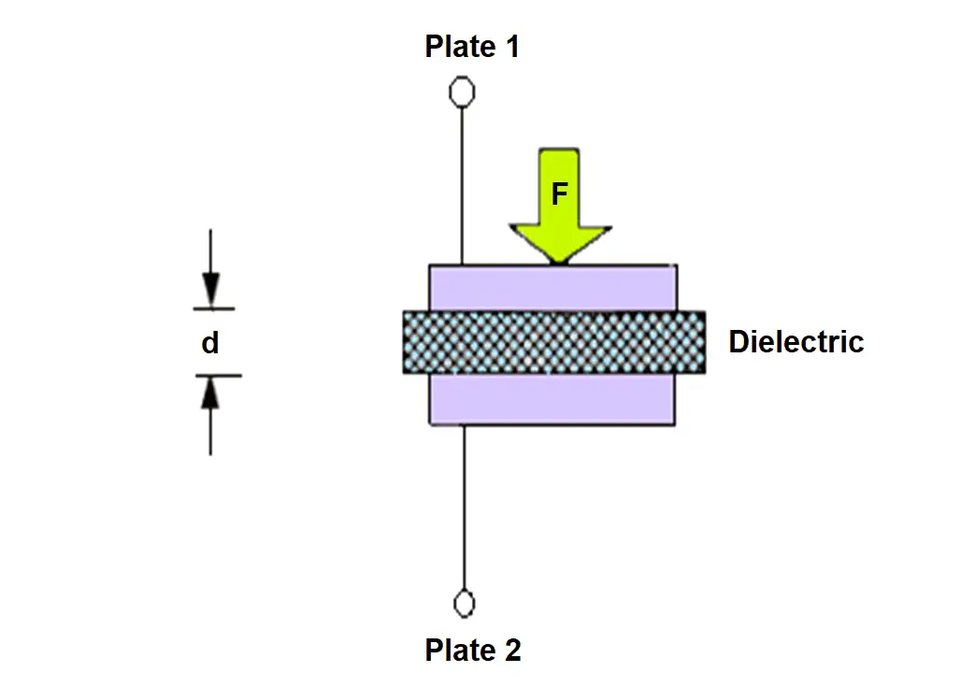
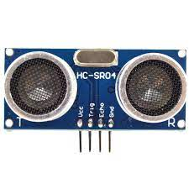
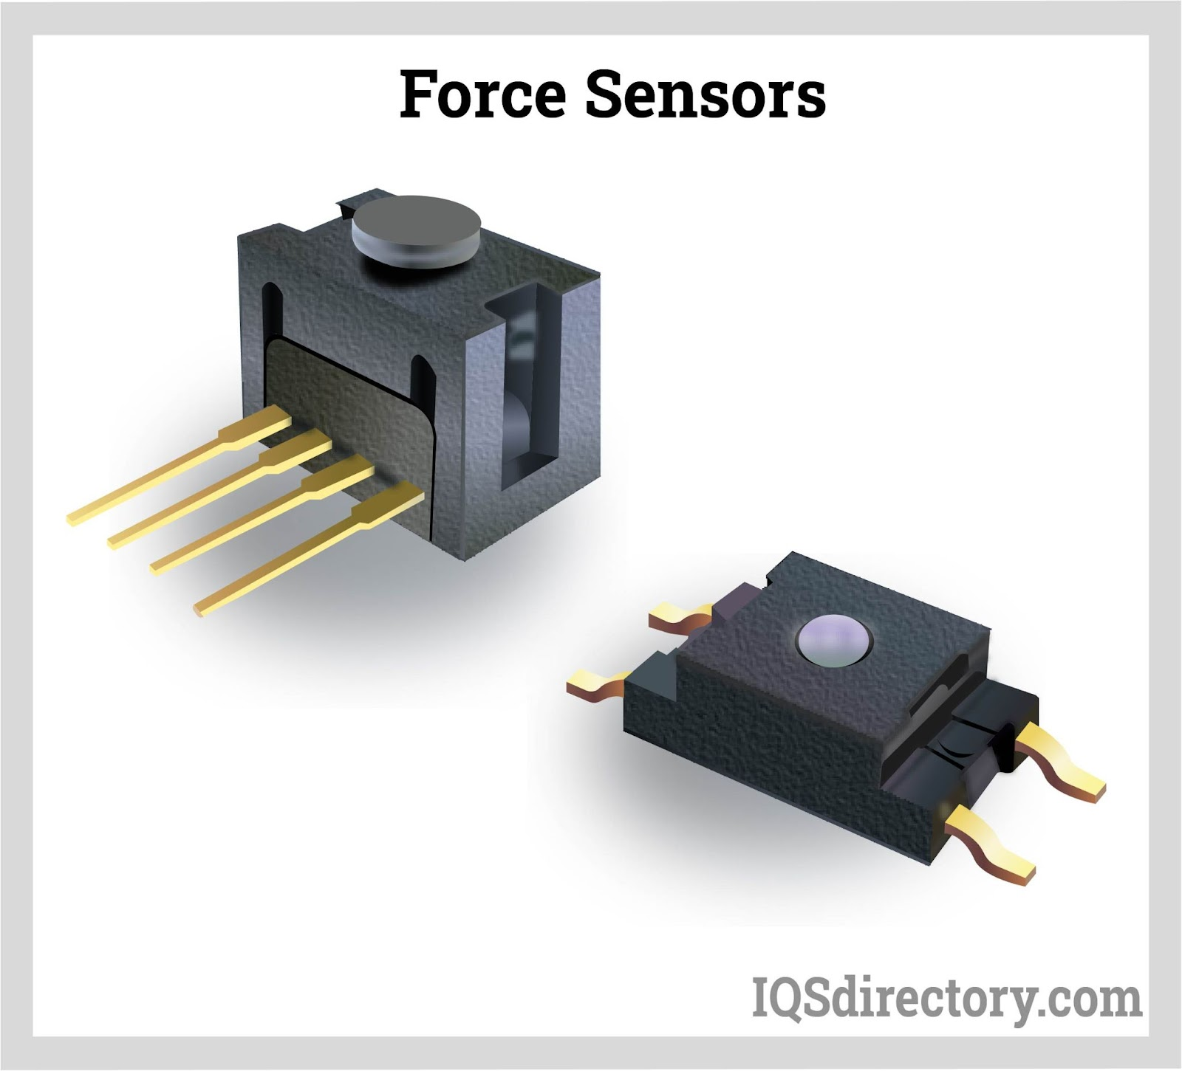
SENSORS
Ultrasonic
Sensor
Force/Torque
Sensor
Tactile
Sensor

Slide 30
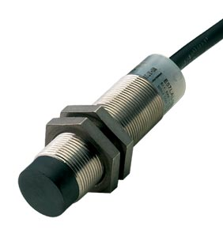
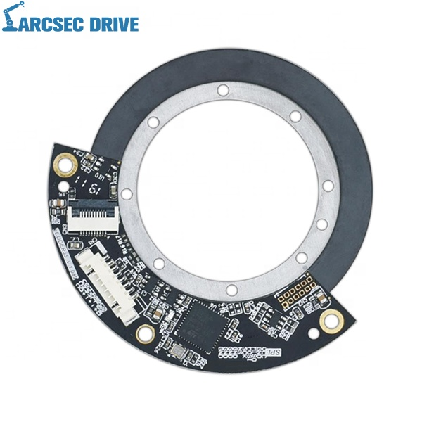
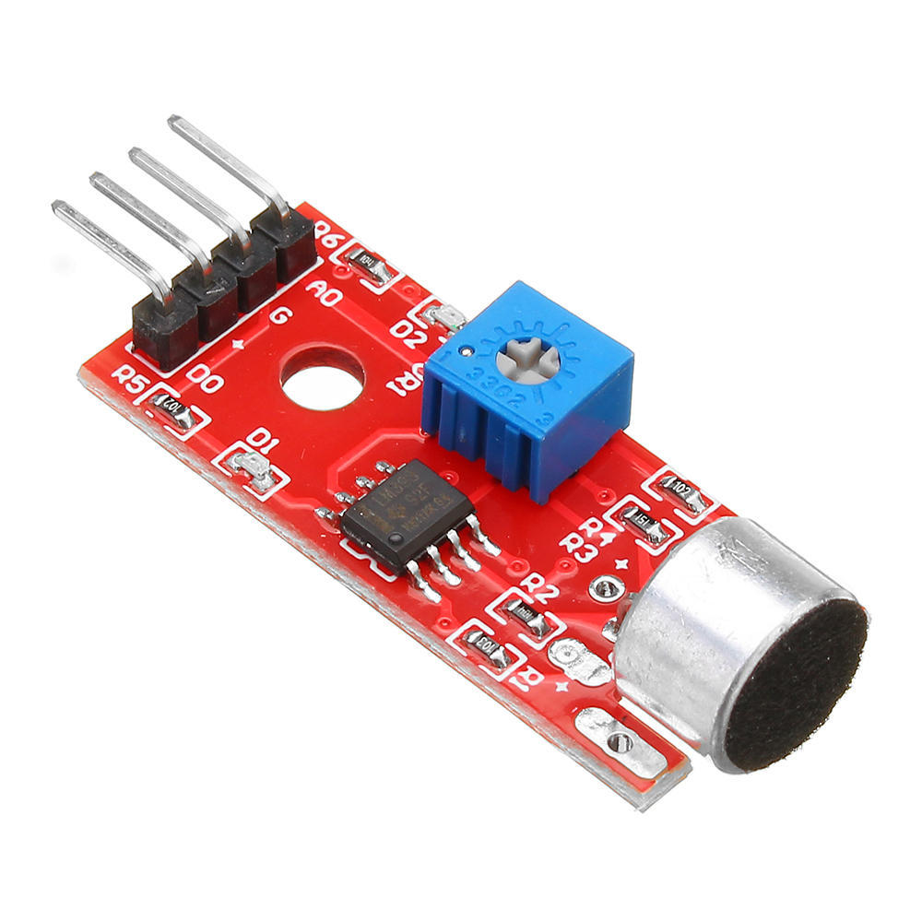
SENSORS
Microphones
Proximity
Sensor
Joint
Encoders

Slide 31
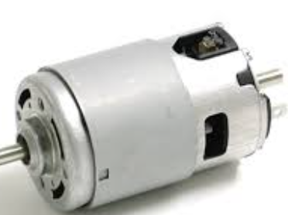
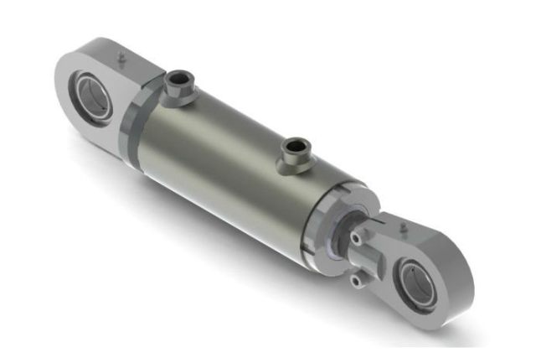
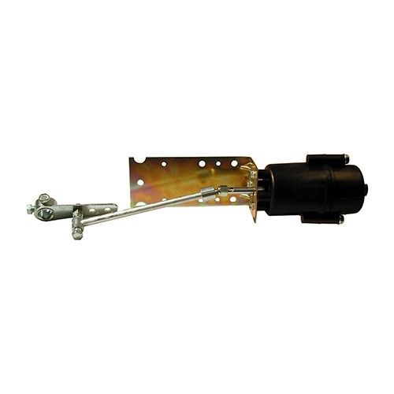
ACTUATORS
Electric
Motors
Hydraulic
Actuators
Pneumatic
Actuators

Slide 32
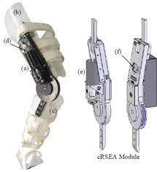
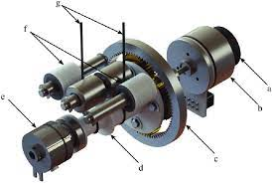
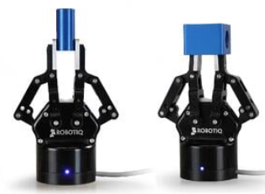
ACTUATORS
SEA
Tendon Drives
End Effectors

Slide 33
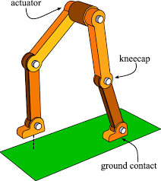
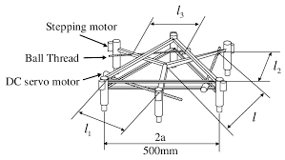
ACTUATORS
Walking Mechanism:

Slide 34
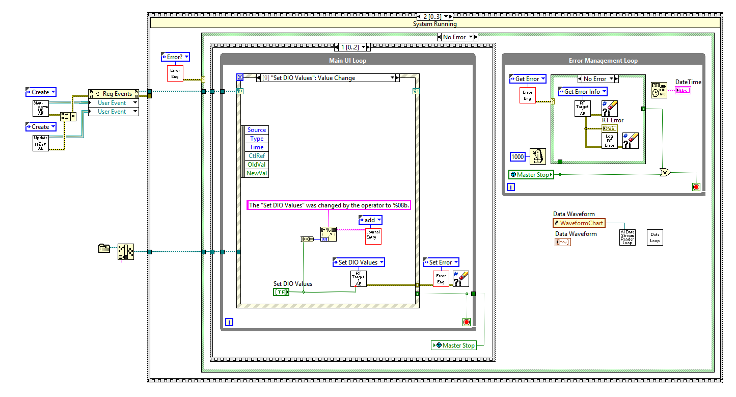
Data Acquisition Software
LabView:

Slide 35
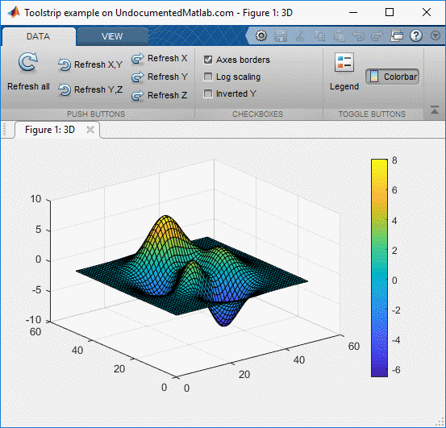
Data Acquisition Software
MATLAB/Simulink:

Slide 36

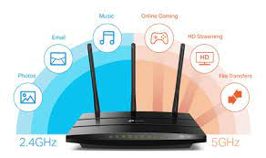
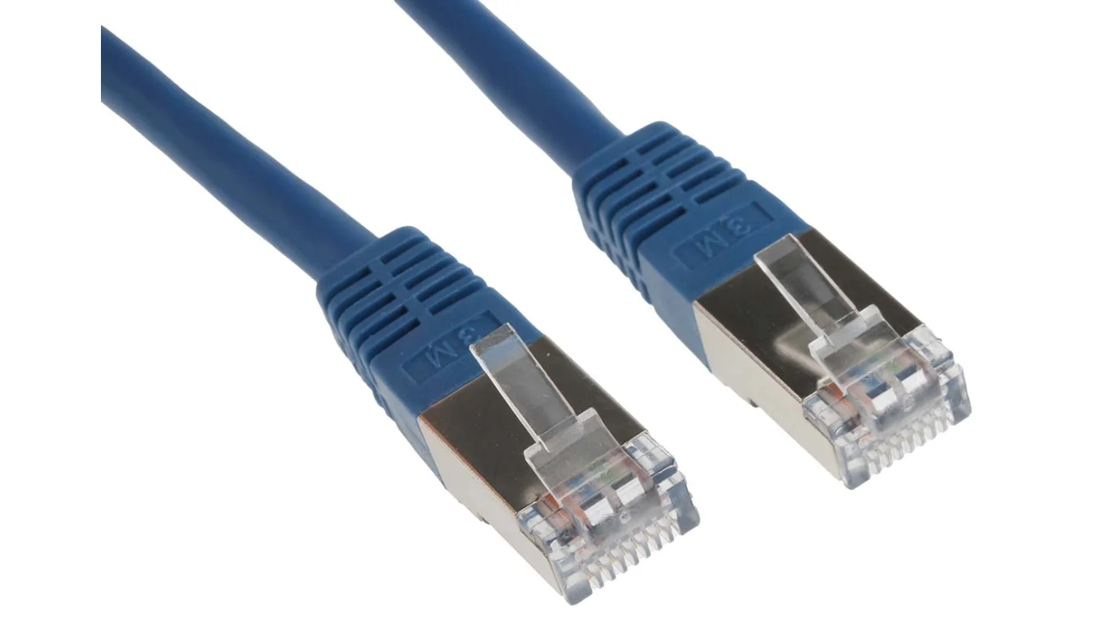
V. Data Transmission
Ethernet:
USB:
Wi-Fi:

Slide 37


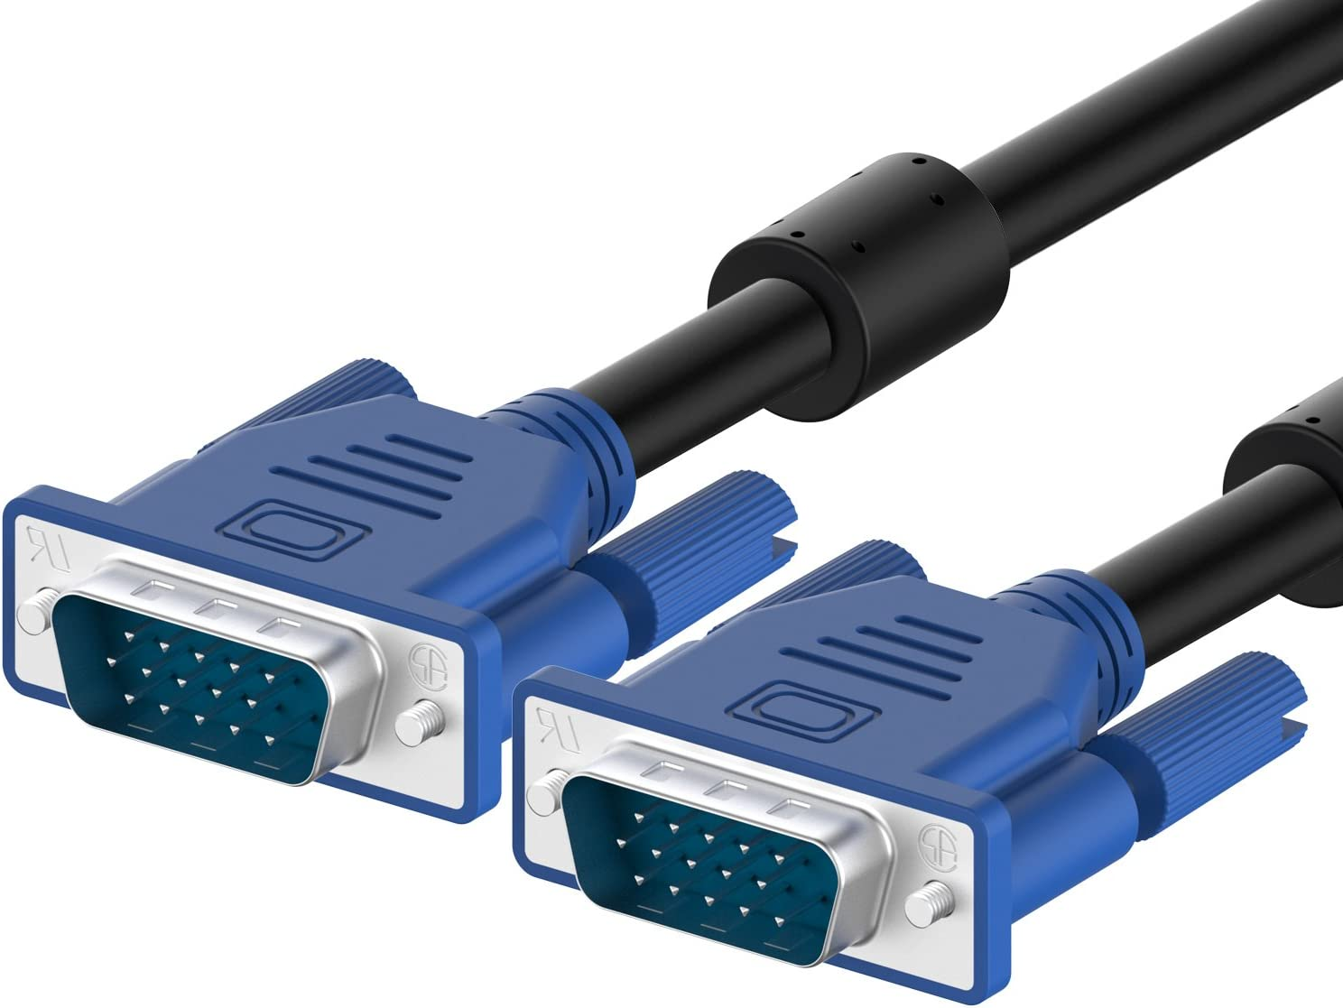
V. Data Transmission
Zigbee:
Radio Frequency:
RS-232:

Slide 38
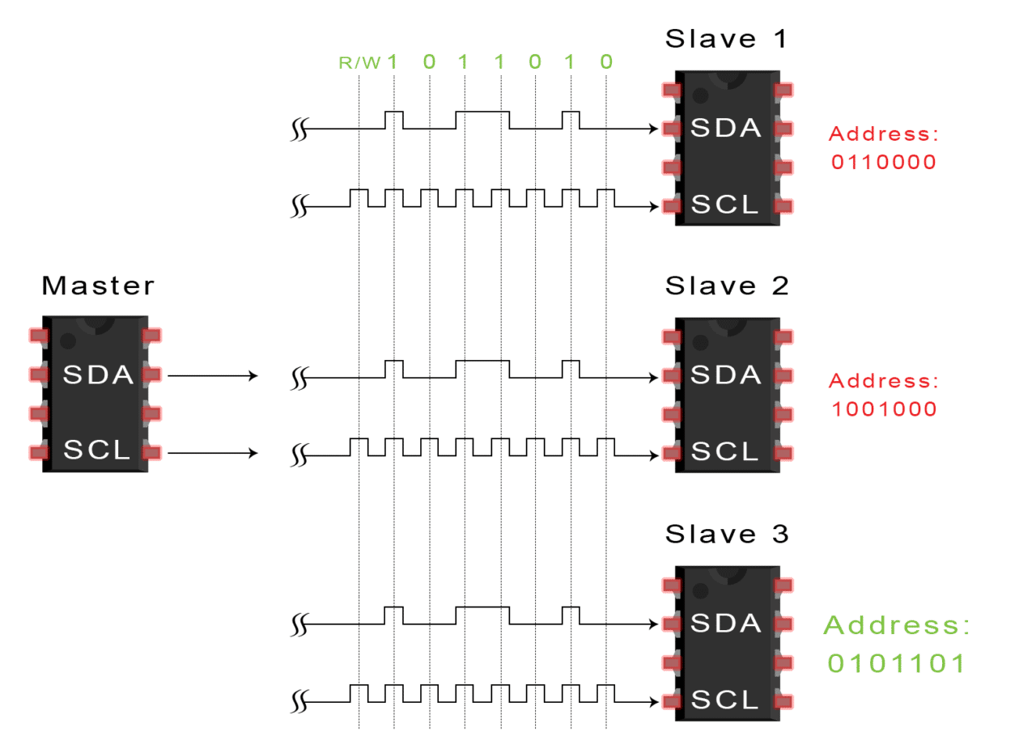
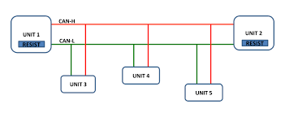
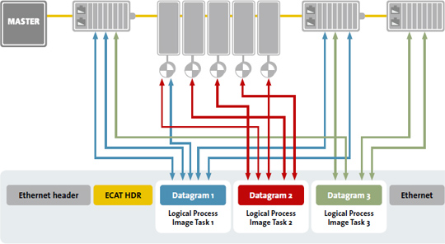
V. Data Transmission
I2C:
CAN:
EtherCAT:

Slide 39
VI. Power Management
Battery Power Management:
Power Saving Techniques:
Power Distribution & Regulation:
Energy Harvesting:
Employ monitoring systems to track the state of the batteries including voltage levels, current draw, temperature, and remaining capacity.
Power management systems regulated the charging and discharging of batteries to ensure optimal performance and prolong battery life.
Can utilize sleep or idle modes for subsystems that are not actively performing tasks.
Employ techniques such as dynamic frequency scaling and voltage scaling to adjust the power consumption of processors and other active components based on workload.
PDUs distribute power from main source to various subsystems and components of the humanoid robot.
Voltage regulators or power converters are employed to maintain stable and appropriate voltage levels for different components
May incorporate solar panels to harness energy from sunlight, providing a renewable and continuous power source.
Robots equipped with moving parts can employ kinetic energy harvesting techniques to convert mechanical motion or vibrations into electrical energy.

Slide 40
04
BUILDING YOUR OWN

Slide 41

Complete Humanoid Robot’s System Architecture

Slide 42

Hands On Session

Slide 43


Slide 44


Slide 45
05 Market Player
Market Player:
Who can use this?
Malaysian Robotics and Automation Group (MyRAG)
UTM
Cyberjaya University College of Medical Sciences (CUCMS)
Healthcare
-Hospitals, clinics, and healthcare facilities.
Education
-Universities, colleges, and schools.
Hospitality and Tourism
Retail
Manufacturing and Industrial Automation
Researchers
Entertainment and Events

Slide 46
Obstacles
Cost
Lack Expertise
Infrastructure
Regulations
Complex and sophisticated machines, making it expensive.
Requires specialized knowledge and expertise in robotics.
Limited in infrastructure to develop humanoid robots.
The deployment of humanoid robots raises various regulatory and ethical considerations.

Slide 47
Top Things To Remember When Using Humanoid Robot
Power Management
Safety
Maintenance
Follow proper safety protocols, including wearing appropriate equipment and ensuring that the robot is operated in a safe environment.
Pay attention to the robot’s power source and monitor battery levels or power supply to prevent unexpected shutdowns or interruptions.
Perform routine maintenance tasks as recommended.
This includes cleaning, lubrication, inspection of mechanical parts and calibration of sensors.

Slide 48
06 Conclusion
In conclusion, humanoid robots represent a remarkable advancement in the field of robotics, mimicking human-like characteristics and capabilities. They hold immense potential in various industries and sectors. As technology move forward, humanoid robots are expected to become more sophisticated, capable, and affordable. It is hoped that the full potential of humanoid robot can be unlocked, enabling us to harness their capabilities for the betterment of humanity.

